Slide 1
Practicing the Scientific Method.
Aim, variables, graphing and analysing the results.

Slide 2
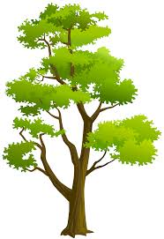
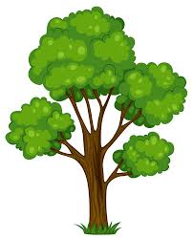
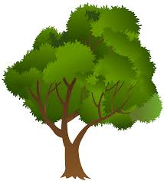
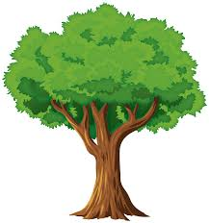
Trees are a non-continuous renewable resource. Although they are used up when they are chopped down for building material or fire wood, another tree can grow in its place.
An Australian botanist wondered about how long it would take for a tree to be replaced. The replacement tree would need to grow from germination of the seed to a mature adult tree.

Slide 3
An Australian botanist hypothesised that all different types of trees take the same amount of time to grow to maturity.
She decided to run an experiment on a few different native tree species to test her hypothesis.

Slide 4
An Australian botanist hypothesised that all different types of trees take the same amount of time to grow to maturity. She decided to run an experiment on a few different native tree species to test her hypothesis.
Identify the variables for her experiment.
Independent (changed)
Dependent (measured)
Control (keep the same)
Type of tree
Time for tree to grow to maturity
Amount of water, type of soil, amount of sunlight etc.

Slide 5
An Australian botanist hypothesised that all different types of trees take the same amount of time to grow to maturity. She decided to run an experiment on a few different native tree species to test her hypothesis.
Write an aim for her experiment.
What are you trying to find out? [To find out if independent affects dependent]
To find out if different trees take different amount of time to reach maturity.

Slide 6
An Australian botanist hypothesised that all different types of trees take the same amount of time to grow to maturity. She decided to run an experiment on a few different native tree species to test her hypothesis.
The botanist recorded her results in the table below.
Draw a graph of her results.
Type of tree | Time to reach Maturity (Years)
Banksia | 10
Acacia | 5
Callistemon | 30
Eucalypt | 10
Grevillea | 4
Independent Data | Dependent Data | Type of Graph
Data is continuous (eg. time) | Data is continuous (eg. height) | Scatter graph
Data is in categories (eg. eye colour) | Data is numerical (eg. number of people) | Column graph

Slide 7
The botanist recorded her results in the table below.
Remember to include:
Descriptive title
Axes labels
Gaps between columns
Type of tree | Time to reach Maturity (Years)
Banksia | 10
Acacia | 5
Callistemon | 30
Eucalypt | 10
Grevillea | 4

Slide 8
Hypothesis: All different types of trees take the same amount of time to grow to maturity.
Do the results support the botanist’s hypothesis?
Restate the hypothesis and state whether it was or was not supported. Explain how you used your results to come to your conclusion. Use specific examples from the data.
The botanist’s hypothesis, that all different types of trees take the same amount of time to grow to maturity, was not supported by the data. The time it took for the Callistemon tree to mature was 30 years. This is much longer than the 4 years it took the Grevillea to mature. This shows that different types of trees grow at different rates.

